Slide 1
Software security
SEng 3071
Chapter 5
Network Management Tools

Slide 2
Presentation outline
  Network Management Tools
  Basic concepts of SNMP
  Proxies
  Distributed Network Management
  Message Processing Model
  User Security Model
  Access Control Processing
  Operating System Security
  Trusted Operating System:
  Developing a secured operating system

Slide 3
Network Management Tools
  Network Management Tools
Network management is the procedure of administering, managing and working a data network using a network management system.
A network management tool allows you to identify problems, set configurations on the network and devices remotely, update configurations of critical network infrastructure devices, and monitor the status of the network and devices.
Network management tools enable you to troubleshoot problems when they occur, remotely access devices as though you are on a network, and remotely manage the power of devices.
In other words, you use a network management tool for all network management aspects.
Furthermore, you use it to monitor performance in real-time and remotely perform actions to maintain the network and troubleshoot issues when they arise.

Slide 4
Network Management Tools
  Basic concepts of SNMP
SNMP (Simple Network Management Protocol)
It is an Internet-standard protocol for handling devices on IP networks.
Devices that typically provide SNMP include routers, switches, servers, workstations, printers and more.
It is used mainly in the network management framework to monitor network-attached computers for conditions requiring regulatory attention.
Network administrators use SNMP to monitor and map network availability, performance, and error rates.
Is an Application Layer (Layer 7) protocol, using UDP (user data gram protocol) ports 161 and 162
Facilitate the exchange of management information b/n network devices.
Notes:
UDP:- user datagram protocol

Slide 5
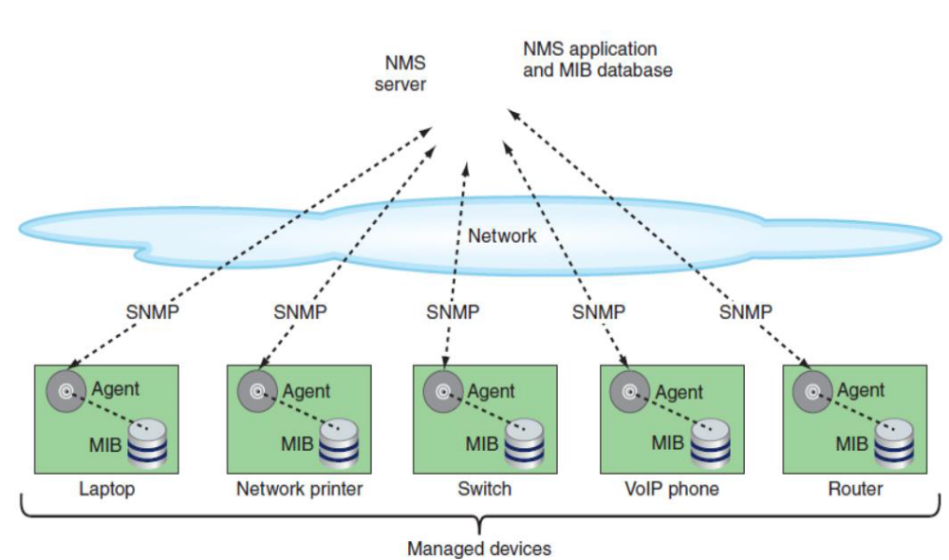
Network Management Tools
  Basic concepts of SNMP
Notes:
MIB (Management Information Base)
is an ASCII text file that describes Simple Network Management Protocol (SNMP) elements as a list of data objects.
Think of it as a dictionary of the SNMP language

Slide 6
Network Management Tools
  Basic concepts of SNMP
Is used more for real-time network monitoring rather than retroactive analysis.
  Port 161 is used to send information from the manager to the installed agents.
  Port 162 is used for agents to send messages to the manager.
SNMP facilitates the concept of manager and agent.
A manager, generally a host, controls and monitors a group of agents, usually routers.
The protocol is designed to monitor different devices and installed on various physical networks at the application level.

Slide 7
Network Management Tools
  Basic concepts of SNMP
An SNMP-managed network includes three key components.
Network management system (NMS)
Executes applications that monitor and control managed devices.
Executes monitoring applications, management processes and controls managed devices.
A network might be managed by one or more management systems.
NMS server:- At least one network management console, which may be a server or workstation, depending on the size of the network, collects data from multiple managed devices at regular intervals in a process called polling.

Slide 8
Network Management Tools
  Basic concepts of SNMP
Agent
An agent is a network-management software mechanism that consists of a managed device.
Each managed device runs a network management agent, which is a software routine that collects information about the device’s operation and provides it to the NMS.
Resides on each managed device and translates local management information data, such as:
  performance information or event and error information caught in software traps, into a readable form for the management system.
  on a server, an agent can measure how many users are connected to the server or what percentage of the processor’s resources are used at any given time. So as not to affect the performance of a device while collecting information, agents demand minimal processing resources.

Slide 9
Network Management Tools
  Basic concepts of SNMP
Managed Device
It is a network node Such as a router, a switch, a computer, or a firewall that executes an SNMP interface that enables unidirectional (read-only) or bidirectional access to node-specific information.
Managed devices collect and store management information, making it available through SNMP to other management systems having the same protocol compatibility.
This can be any characteristic of the device that is monitored, including components such as a processor, memory, hard disk, or NIC, or intangibles such as performance or utilization.
Each managed object is assigned an OID (object identifier), which is standardized across all NMSs.

Slide 10
Network Management Tools
  Basic concepts of SNMP
Three SNMP commands used to manage (monitored and controlled) devices:
Read, Write, and Trap.
The read command is used by an NMS to monitor managed devices.
This is performed by the NMS examining different variables that are maintained by managed devices.
The write command is used by an NMS to control managed devices.
Using this command, the NMS can change the values of variables stored within managed devices.
The trap command is used by NMS managed devices to report events to the NMS.
NOTE:- Monitoring involves collecting and analyzing data from the devices. Controlling uses these findings to make changes.

Slide 11
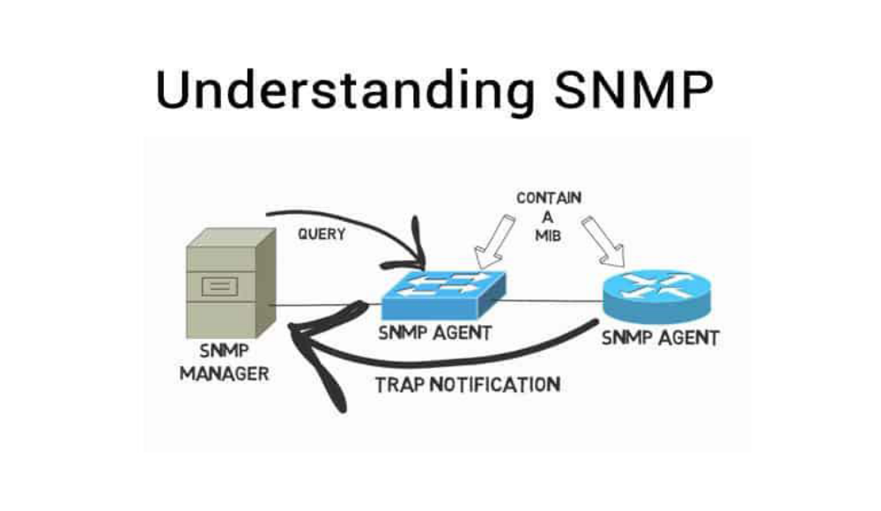
Network Management Tools
  Basic concepts of SNMP
Notes:
MIB:- Management information Base

Slide 12
Network Management Tools
  Basic concepts of SNMP
Versions of SNMP -Versions 1, 2, and 3.
Version 1 (1988), or SNMPv1, Now rare
  Is the initial implementation of the SNMP protocol. operates over protocols such as User Datagram Protocol (UDP), Internet Protocol (IP), and the OSI Connectionless Network Service (CLNS).
SNMPv2 –still widely used
  Revises SNMPv1 and includes improvements in the areas of performance, security, confidentiality, and manager-to-manager communications. SNMPv2 also defines two new operations: Get-Bulk and Inform.
  The Get Bulk operation is used to retrieve large blocks of data efficiently.
  The Inform operation allows one NMS to send trap information to another NMS and then to receive a response.

Slide 13
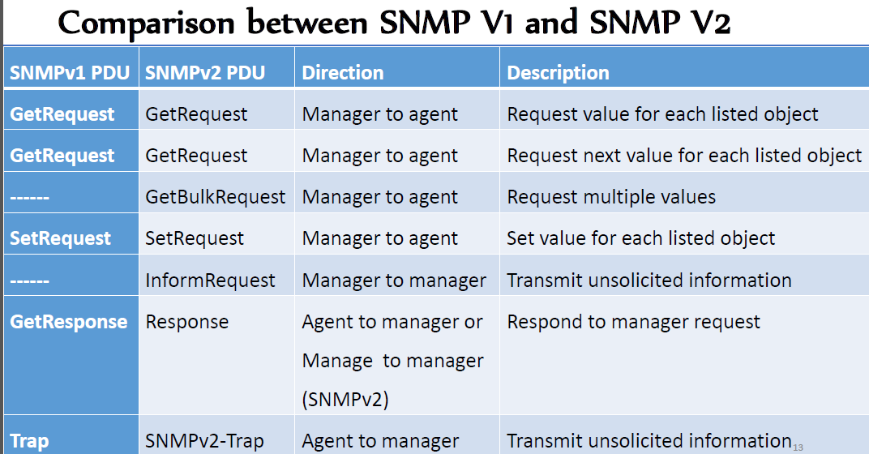
Network Management Tools
  Basic concepts of SNMP
Notes:
Each SNMP message contains a protocol data unit (PDU).
These SNMP PDUs are used for communication between SNMP managers and SNMP agents.

Slide 14
Network Management Tools
  Basic concepts of SNMP
SNMPv3
  This version is similar to SNMPv2 and adds three additional security services authentication, validation, and encryption for messages exchanged between managed devices and the network management console.
  SNMPv3 uses message integrity to ensure that a packet has not been tampered with in-transit.
  SNMPv3 also utilizes authentication, which is used to determine whether the message is from a valid source.
  SNMPv3 provides encryption, which is used to scramble the contents of a packet to prevent it from being seen by unauthorized sources.
  Information is exchanged between a management station and an agent in the form of an SNMP message.
Notes:
An SNMP trap message is an unsolicited message sent from an agent to the manager.
The objective of this message is to allow the remote devices to alert the manager in case an important event happens.

Slide 15
Network Management Tools
  Proxies
A proxy concept was developed to accommodate devices that do not implement SNMP.
The SNMP agent acts as a proxy for one or more other devices; it acts on behalf of those devices.
The management station sends queries concerning a device to its proxy agent.
The proxy agent converts the query into the management protocol that is used by the device and when the reply arrives, it passes the reply back to the management station.
It also sends a trap message when an event notification is transmitted to proxy agent from the device.
For SNMPv2, proxy is the only means of managing the devices that do not implement SNMPv2. It also includes SNMPv1.

Slide 16
Network Management Tools
  Proxies
Proxy & Gateway Agents extend the capabilities of SNMP by allowing it to:
  Manage a device that cannot support an SNMP agent
  Manage a device that supports a non-SNMP management agent
  Allow a non-SNMP management system to access an SNMP agent
  Provide firewall-type security to other SNMP agents (UDP packet filtering)
  Translate between different formats of SNMP messages (v1 and v2)
  Consolidate multiple managed nodes into a single network address (also to provide a single trap destination)

Slide 17
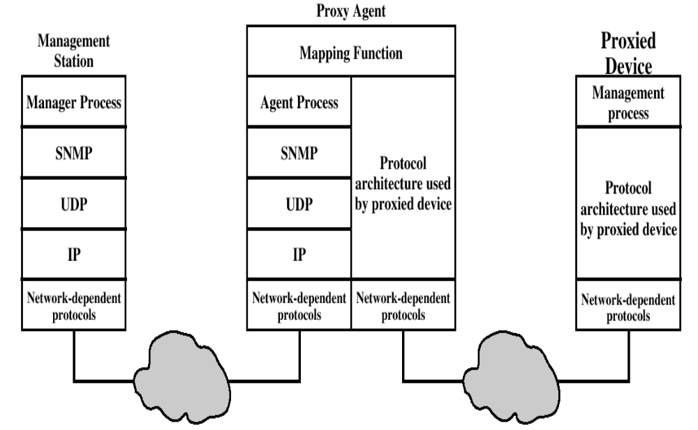
Network Management Tools
  Proxies

Slide 18
Network Management Tools
  Distributed Network Management
A traditional network management scheme involves a host acting as a management station and the remaining devices acting as agents, which for large networks with high traffic infeasible.
In a decentralized network management scheme, multiple top level management stations are present, referred to as management servers, which manage a portion of total pool of agents.
For many agents, the management server delegates responsibility to an intermediate manager who plays the role of manager to monitor and also agent to convey information to higher level management.
SNMP supports either a highly centralized network management strategy or a distributed one.

Slide 19
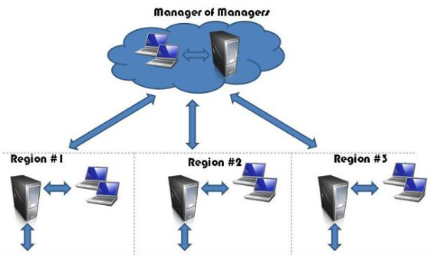
Network Management Tools
  Distributed Network Management
Distributed network management is the creation of multiple core locations that are used to administrate and control various resources of a computer network.

Slide 20
Network Management Tools
  Message Processing Model
The following five fields are generated by the message processing model on outgoing messages and process by the message processing model on incoming messages.
Msg-Version: set to SNMPv3
Msg-ID: identifier used between two SNMP entities to coordinate request and response messages and by the message processor to coordinate the processing of message by different subsystem models within the architecture.
Msg-Max-Size: conveys the maximum size of a message in octets supported by the sender of the message.
Msg-Flags: an octet string containing three flags in the least significant three bits: reportable-Flag, private-Flag, authenticated-Flag
Msg-Security-Model: an identifier that indicates which security model was used by the sender to prepare this message and therefore which security model the receiver must use to process this message.

Slide 21
Network Management Tools
  User Security Model
USM provides authentication and privacy services for SNMP.
USM supports privacy of messages.
Uses DES technique for encrypting and decrypting SNMPv3 packets.
In the same way as with authentication, the same secret privacy key is used to encrypt and decrypt messages on both sides.
It is designed to protect:
Modification of information
Masquerade
Message stream modification
Disclosure
This model is not intended to protect:
Denial of service attacks: an attacker may prevent exchanges between a manager and an agent.
Traffic analysis: an attacker may observer the general pattern of traffic between a manger and agents
Notes:
DES stands for Data Encryption Standard.
The DES algorithm uses a key of 56-bit size.
Using this key, the DES takes a block of 64-bit plain text as input and generates a block of 64-bit cipher text.

Slide 22
Network Management Tools
Access Control Processing
All of these parameters are needed to make the access control decision.
Who: the combination of security model and security Name define the who of this operation; it defines a given principal whose communications are protected by a given security model.
Where: the context Name specifies where the desired management object is to be found.
Why: the view type specifies why access is requested: for a read, write or notify operation.
What: the variable Name is an object identifier whose prefix identifies a specific object type and whose suffix identifies a specific object instance. The object type indicates what type of management information is requested.
Which: the object instance indicates which specific item of information is requested.

Slide 23
Network Management Tools
Operating System Security
Security refers to providing a protection system to computer system resources such as CPU, memory, disk, software programs and most importantly data/information stored in the computer system.
If a computer program is run by an unauthorized user, then he/she may cause severe damage to computer or data stored in it.
So a computer system must be protected against unauthorized access, malicious access to system memory, viruses, worms etc.
We distinguish between protection and security:
Protection refers to a mechanism for controlling the access of programs, processes or users to the resources. It must provide means for specifying the controls to be imposed.
Security is a measure of confidence that the integrity of a system and its data will be preserved.

Slide 24
Network Management Tools
Operating System Security
Reasons for protection
Prevent the mischievous, intentional violation of an access restriction
Ensure that each program component uses system resources only in ways consistent with system policies
Protection is strictly an internal problem and Security, however, requires also consideration of the external environment
A protection system is ineffective, for instance, if user authentication is compromised
A protection oriented system provides means to distinguish between authorized and unauthorized usage

Slide 25
Network Management Tools
Operating System Security
The Security Problem
Security violations can be categorized as intentional or accidental.
It is easier to protect against accidental security violations
Protection methods mostly consider accidental security violations
A threat is a potential for a security violation
An attack is the attempt to break security. It includes Breach of confidentiality, Breach of integrity , Breach of availability, Theft of service and Denial of service

Slide 26
Network Management Tools
Operating System Security
Every computer system and software design must handle all security risks and implement the necessary measures to enforce security policies.
At the same time, it's critical to strike a balance because strong security measures might increase costs while also limiting the system's usability, utility, and smooth operation.
As a result, system designers must assure efficient performance without compromising security.
OS security refers to the processes or measures taken to protect the operating system from dangers, including viruses, worms, malware, and remote hacker intrusions.

Slide 27
Network Management Tools
Operating System Security
Operating system security (OS security) is the process of ensuring OS integrity, confidentiality and availability.
OS security refers to specified steps or measures used to protect the OS from threats, viruses, worms, malware or remote hacker intrusions.
OS security encompasses all preventive-control techniques, which safeguard any computer assets capable of being stolen, edited or deleted if OS security is compromised.
OS security may be approached in many ways, including adherence to the following:
  Performing regular OS patch updates
  Installing updated antivirus engines and software
  Examining all incoming and outgoing network traffic through a firewall
  Creating secure accounts with required privileges only (i.e., user management)

Slide 28
Network Management Tools
Trusted Operating System
An OS is trusted if it can provide:-
Memory Protection
Each user’s program must run in a portion of memory protected against unauthorized accesses.
File Protection
aims to prevent programs from replacing critical OS files
General object access control
Users need general objects, such as constructs to permit concurrency and allow synchronization
User Authentication
must identify each user who requests access and must ascertain that the user is actually who purports to be.

Slide 29
Network Management Tools
Trusted Operating System
The key features of a Trusted OS are:
Identification and Authentication:- who is requesting access to an object,
Mandatory access control (MAC):- A central authority determines access, user cannot change access rights.
Discretionary access control (DAC):- The owner can determine who should have access rights to an object and what those rights should be.
Object Reuse Protection:- reuse objects rather than completely destroy them.
Complete Mediation:- all accesses must be controlled and verified.
Trusted path:- attackers can’t intercept or modify information.
Accountability and Audit:- protect the audit logs from outsiders, and record every security relevant event.
Audit Log Reduction:- change the log location, or reduce the size based on needs
Intrusion Detection:- detect some attacks

Slide 30
Network Management Tools
Trusted Operating System
There are a few basic concepts that are fundamental when dealing with trusted OS:
The kernel:- is the part of the OS that performs the lowest-level functions
the security kernel:- is responsible for enforcing the security mechanisms of the entire OS
The reference monitor (RM):- is the part of the security kernel that controls access to objects.
The trusted computing base (TCB):- is everything in the trusted OS necessary to enforce the security policy
Security Policy and Security Model
A security policy is a statement of the security we expect the system to enforce.
The security can be expressed as a number of well-defined, consistent and implementable rules.
A security model is a representation of the security policy for the OS.

Slide 31
Network Management Tools
Trusted Operating System
Developing a secured operating system
The development of secure OS can be made in six steps:
Analyse of the system
Choose/define a security policy
Choose/create a security model (based on the policy)
Choose implementation method
Make a (conceptual) design
Verify the correctness of the design
Make an implementation
Verify the implementation
There are feed-back loops between all of the above steps. Errors may occur in all above steps.

Slide 32
Thank you
???

